Slide 1



Ratings for RISCA services – eight weeks on
Update for NAB
Notes:
Nev – [thank you Ruth]
As you know, we are now over two months into ratings being published for RISCA services. We thought it would be useful for you to hear what we have been up to during that time and what our next steps will be

Slide 2
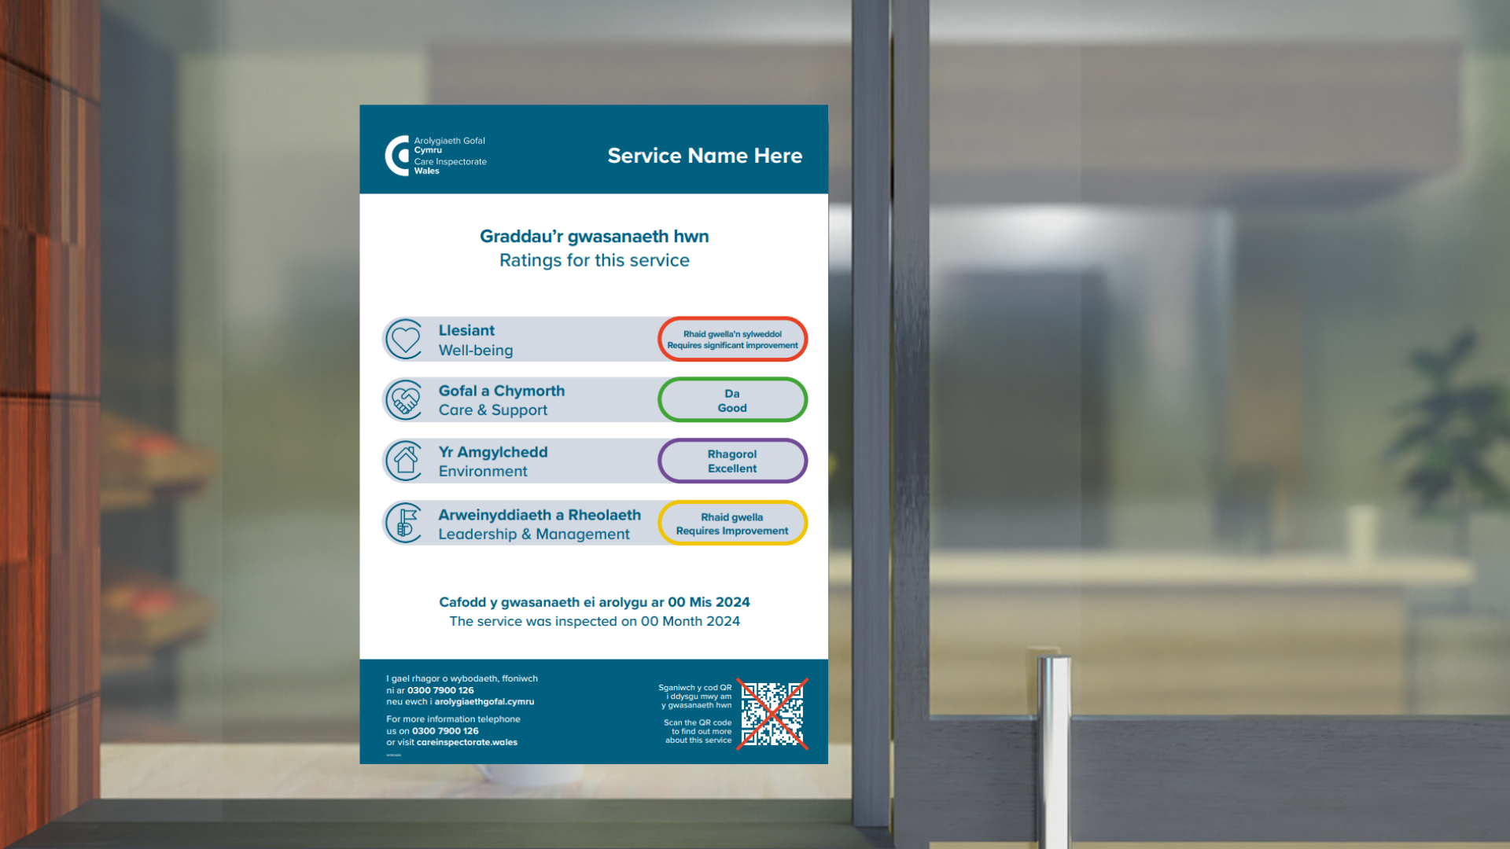
Since 1 April …
139 services have been inspected against the new framework
35 inspection reports have been published *
* Number of inspections with an actual date between 1st April and 19th May 2025 with a status of 'Inspection completed - report published'
Notes:
NEV -

Slide 3
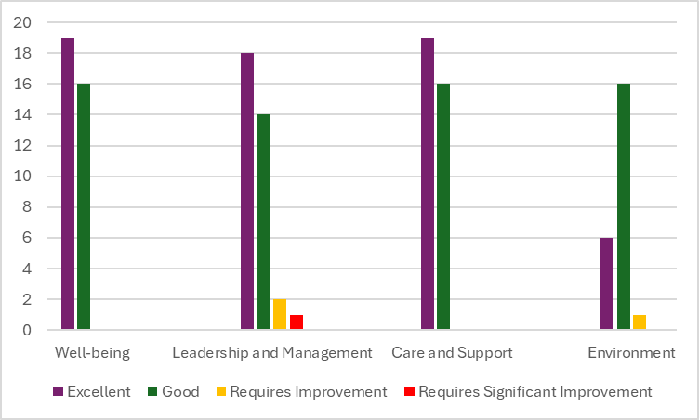
Ratings so far …
Notes:
NEV

Slide 4
Feedback from inspectors …
87% inspectors rated the training and development programme Excellent or Good
96% inspectors feel they have had enough support to implement the new framework and ratings system
The ratings team have done a really good job with the process from start to finish. Information provided clearly and group sessions supported us to use new ways in practice.
The group work raised some interesting points across all subjects and it was beneficial to meet with other staff working in different areas within CIW and geographically
L& D brochure very helpful in setting out the sessions and objectives.
The presenters did a great job explaining the changes and how to apply the ratings - a difficult job
Notes:
NEV – training took place throughout March whilst inspections were on hold – combination of different training methods etc

Slide 5
Feedback from providers …
784 providers and commissioners attended the ratings events in March
97% providers rated the ratings events as Excellent or Good
76% providers thought that there wasn’t anything else CIW can do to support them through these changes
Very informative, presentation was great and presenters knowledgeable. Links for all documentation / regulations and guides was extremely useful and will use the checklist to ensure not only we are compliant with all regulations, but that staff are informed of the ratings and what they mean.
There has obviously been a lot of work undertaken and it has been a refreshing approach. I think that we are in a good position and well prepared.
Feeling that we have been involved and listened to - I can’t think of how things could have been done differently.
I think the descriptors are very good.
Notes:
Annette – Thanks Nev
We’ve also had some really positive feedback from our providers.
We held 3 events for providers and commissioners in March and 784 people attended. We surveyed attendees after the event and here’s a summary of some of the feedback.
97% providers rated the ratings events as Excellent or Good
76% providers thought that there wasn’t anything else CIW can do to support them through these changes
I’ve also included some quotes from providers in the slide. I won’t read them all out but you get a real flavour of how much value and appreciation there is for the level of support CIW has given [read purple circle]

Slide 6
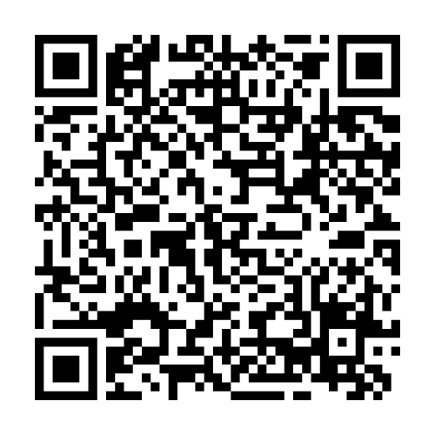
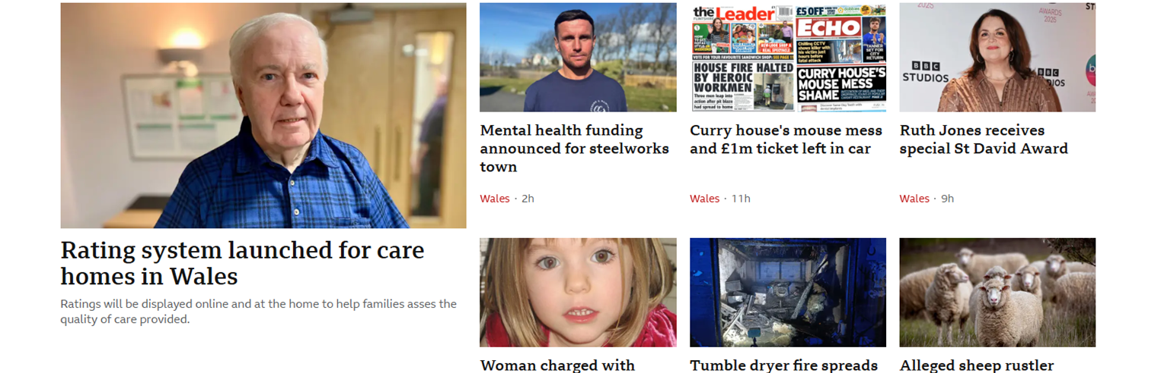
Media coverage …
Watch feature on the ITV News
Notes:
Annette – So, looking at the media coverage for the launch of ratings.
We have received an enormous amount of positive publicity about ratings. There was unprecedented media interest from traditional and digital media channels at a local and national level. At one point we were the headline news on the BBC news channels which is fantastic.
The minister visited a nursing home in South Wales to publicise the launch of ratings and that was covered by all the major new channels.
Scan the QR code to watch the news article.

Slide 7



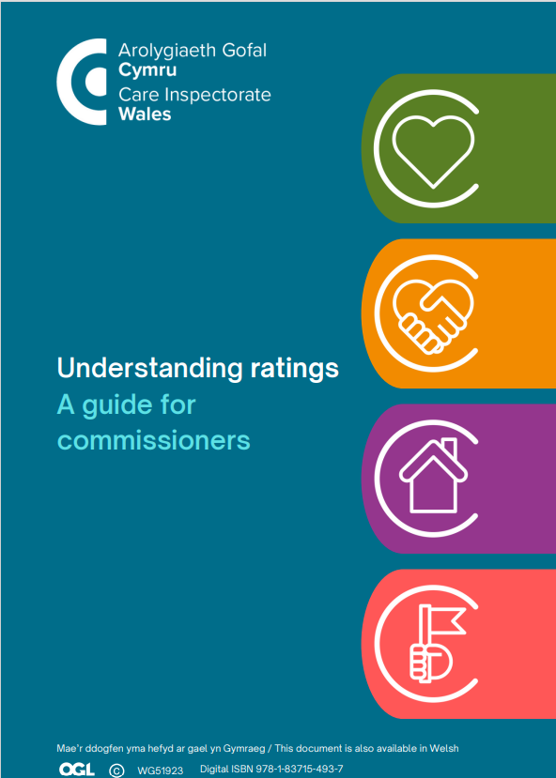
Notes:
The last slide from me.
I just wanted to remind you all that there is a wide selection of guidance materials on our website including:
Displaying ratings guidance
A pre inspection checklist
A guide for care workers
A guide for commissioners
I will hand you back to Nev

Slide 8
Next steps …
Surgeries for inspectors
Embedded ratings training into induction programme
Refreshing post inspection feedback to incorporate ratings
Keeping the conversation ‘live’
Provider events in September
Evaluation of ratings programme (once all services have received ratings)
Notes:
NEV

Slide 9
What are you hearing, thinking, feeling about ratings?
Notes:
Nev / Julie

