Slide 1
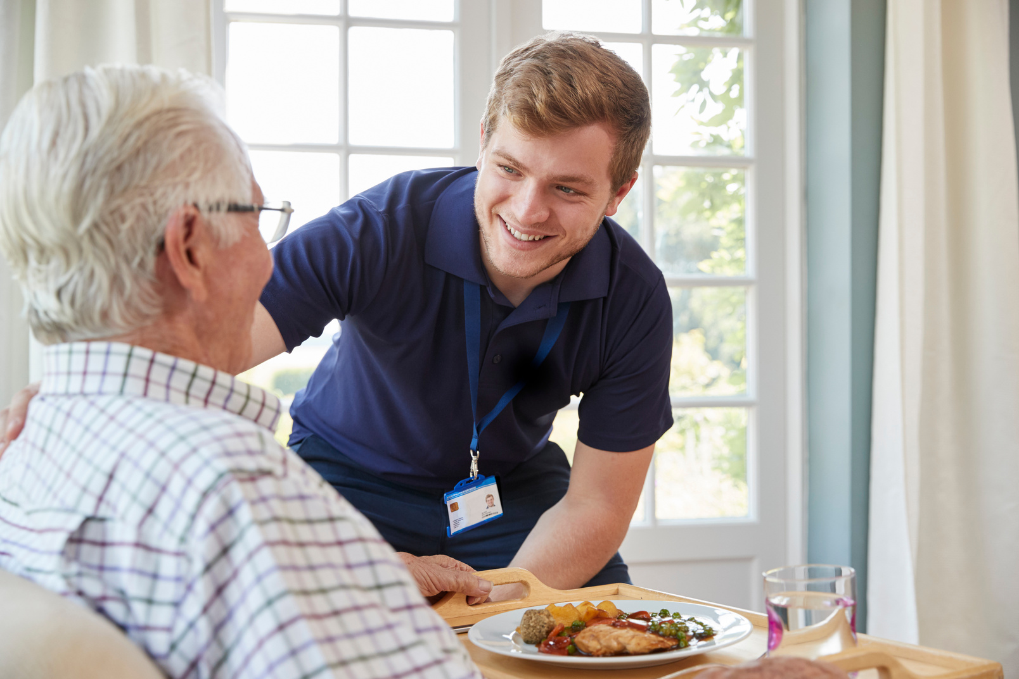


‘Influence’
How can we promote what CIW does?
Notes:
Thanks Ruth
And hi everyone. I’m Annette Hennessey and I manage the comms and engagement team in CIW.
The purpose of this session today is for you to help us with an important element of our new strategic plan – influence.

Slide 2
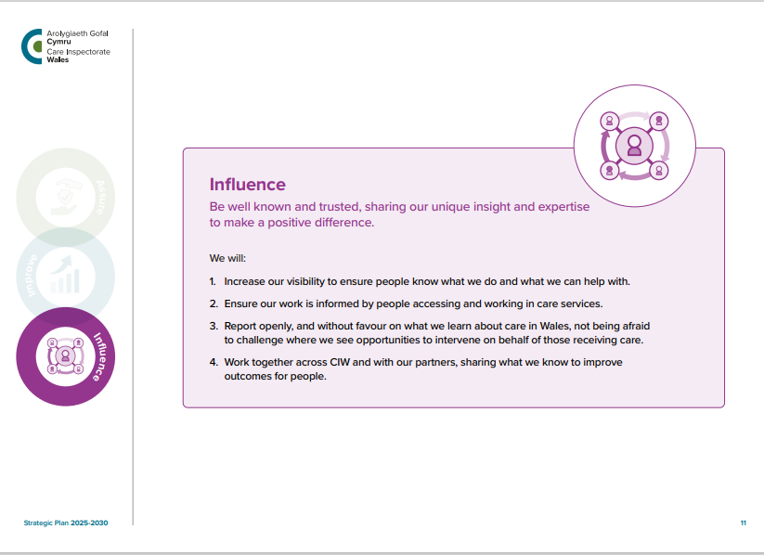
Notes:
Influence is one of the three core themes of our strategic plan We want to be ‘well known and trusted, sharing our unique insight and expertise to make a positive difference’.
Today I would like us to focus on objectives 1 and 2 which are:
We will increase our visibility to ensure people know what we do and what we can help with
We will ensure our work is informed by people accessing and working in care services

Slide 3

By the end of this session we will …
Identify our key audiences and messaging
Who most needs to know about CIW's work?
What unique aspects of CIW's work should we highlight?
Channels and Implementation (10 minutes)
Which communication channels would be most effective?
How might advisory board members personally support these efforts?
Notes:
So, by the end of this session we will talk about:
Our key messages and audiences -who most needs to know about CIW’s work and what should we be telling them?
And secondly – we will talk about the different communication channels we have at our disposal to ensure maximum impact.

Slide 4

What one word comes to mind when you think about CIW's current public profile?
TASK 1
Notes:
But before we start, let’s get started with just one word.
The foundation to any effective communication is to keep it simple, so I want just one word from each of you that describes CIW’s current public profile.
Richard, please can you launch the wordcloud.
Could you all please give us one word that comes to mind when you think about CIW’s currently public profile. And please be honest.
Your word will appear in the word cloud but will be anonymous.
[show on screen]

Slide 5

What CIW colleagues are telling us …
Increasing visibility at key events
Information sessions
Accessibility of information for all
Communicating in different ways
Social media training for staff
Notes:
We’ve already done a lot of work with our CIW colleagues about how we can expand our public profile. This is a summary of over 1000 suggestions we’ve had to date.
Increasing visibility at care shows and events, with partners where possible
Facilitating information sessions for social care and childcare students, new police officers, and other relevant organisations
Accessibility of information for all: Recognising some people do not use the internet. Consider leaflets, posters in prominent places such as GP waiting rooms
Communicating using video and audio for shorter, snappier communication
Regular social media sessions for staff to build their confidence
Now, we would like to get your thoughts on how we prioritise some of this work going forward.

Slide 6
Audience and messaging …
What unique aspects of CIW's work should we highlight?
Who most needs to know about CIW’s work?
Notes:
We will discuss this as a whole group if that’s OK?
This first discussion is all about identifying our main audiences. Who needs to know about us?
[prompt if needed]
Thanks everyone – some really useful suggestions there.
The next focus is all about our messaging. What unique aspects of CIW's work should we highlight?
[prompt if needed]

Slide 7
Channels and implementation …
Which communication channels would be most effective?
Notes:
So, we’ve talked about our audience and messaging. Now, let’s move onto our third question which is all about what channels we can utilise to make sure all our main stakeholders are getting the right messages at the right time.
[Group discussion]
Prompts – how can we actively get feedback from those that use our services? Particularly those that have additional needs?

Slide 8

What CIW channels do you already access?
Notes:
Before we move onto the final question, I just wanted to get an understanding of what interaction members have with CIW channels at the moment, so I’ve prepared a few questions, please answer honestly.
First question: Do you follow CIW on our social media channels? [Richard add poll]
Second question: for those that answered yes, can you tell us which of our social media channels you follow [Richard to add poll]
And last but not least ‘Do you subscribe to CIW’s quarterly bulletin? [Richard add poll]
[Discuss results].

Slide 9

How can you support us to promote what CIW does?
Notes:
And lastly, its over to you. This last question is ‘ how can you, or your respective organisations, support us to promote what CIW does?
[Group discussion]

Slide 10

Next steps …
Develop a new communications and engagement strategy and implementation plan. This will include:
A 360 review of all our current communications channels
Our events
Upskilling CIW colleagues
Resource hub for providers
Website Spring clean
Tone of voice
Notes:
[Thank everyone for their feedback]
So, what happens next? We will be working with our main stakeholders to develop a new communications and engagement strategy and implementation plan. This will include:
A 360 review of all our current communications channels to identify strengths and weaknesses
Developing a more strategic, evidence-based approach to our events
Upskilling CIW colleagues, including social media and crisis communications training
Developing a one stop resource hub for providers via CIW Online
Making sure the CIW website is fit for purpose and easy to navigate
Developing clear guidelines on our collective tone of voice
Thanks again for your feedback. We will use this to help inform this strategy and how we take this work forward.

