Slide 1
CIW Provider Events Digwyddiadau i Ddarparwyr AGC
Autumn / Hydref 2023

Slide 2
Agenda
Croeso & Diweddariadau gan AGC (10 munud)
Datganiadau Blynyddol (15 munud)
Graddau (15 munud)
Egwyl (5 munud)
Rôl yr Unigolyn Cyfrifol (20 munud)
Adolygiad o ansawdd y gofal – trafodaeth (30-40 munud)
Welcome & CIW Updates (10 minutes)
Annual Returns (15 minutes)
Ratings (15 minutes)
Comfort break (5 minutes)
Role of the RI (20 minutes)
Quality of care review – discussion (30-40 minutes)

Slide 3
Diweddariadau / Updates
Deprivation of Liberty Safeguards (DoLS)
LPS on hold for at least life of this UK government
re-focus on DoLS and provider's responsibilities as Managing Authorities
notify CIW when applying for authorisation
most interested in how care and support is delivered for people deprived of their liberty in the least restrictive ways
piloting a renewed focus on DoLS as part of our inspection visits - lack of understanding by many care staff of DoLS, lack of response by LAs people waiting long time for authorisation - we're interested in provider's experiences of this.
important to remember DoLS are not open-ended / for life and should be reviewed by LA.
Trefniadau Diogelu wrth Amddifadu o Ryddid
Diogeliadau Amddiffyn Rhyddid wedi'u gohirio o leiaf am oes Llywodraeth bresennol y DU
ailganolbwyntio ar y Trefniadau Diogelu wrth Amddifadu o Ryddid a chyfrifoldebau darparwyr fel Awdurdodau Rheoli
hysbysu AGC wrth wneud cais am awdurdod
y prif ffactor sydd o ddiddordeb yw sut y rhoddir gofal a chymorth i bobl a gaiff eu hamddifadu o'u rhyddid yn y ffyrdd lleiaf cyfyngol
cynnal cynllun peilot yn canolbwyntio o'r newydd ar y Trefniadau Diogelu wrth Amddifadu o Ryddid fel rhan o'n hymweliadau arolygu - diffyg dealltwriaeth llawer o staff gofal o'r Trefniadau Diogelu wrth Amddifadu o Ryddid, diffyg ymateb gan Awdurdodau Lleol a phobl yn aros am amser hir i gael awdurdod - rydym yn awyddus i glywed am brofiadau darparwyr o hyn
mae'n bwysig cofio nad yw'r Trefniadau Diogelu wrth Amddifadu o Ryddid yn benagored / yn drefniadau gydol oes a dylai'r Awdurdod Lleol eu hadolygu.

Slide 4
Diweddariadau / Updates
Notifications and safeguarding
Vaccination The Flu/COVID One eLearning module has been updated for 2023/24.
Flu/COVID One e-Learning
If you do not have a login, contact
eateb@wales.nhs.uk with your name, job title
and place of work to gain access to this module.
Hysbysiadau a diogelu
Mae'r modiwl e-Ddysgu Vaccination The Flu/COVID One wedi cael ei ddiweddaru ar gyfer 2023/2024.
e-Ddysgu Flu/COVID One
Os nad oes gennych fanylion mewngofnodi,
cysylltwch â eateb@wales.nhs.uk gan nodi eich
enw, eich teitl swydd a’ch gweithle er mwyn gallu gweld y modiwl hwn.

Slide 5
Datganiadau Blynyddol / Annual Returns
Total submissions
1,021 providers were required to submit an annual return
Pre-publication checks
‘Completeness’ checks 276
Parameters:
Size of service
Welsh language
Azure AI checks
personally identifiable information or offensive content.
924 checks carried out
3 transactions with offensive content
390 transactions with potentially identifiable information
Cyfanswm y cyflwyniadau
Roedd yn ofynnol i 1,021 o ddarparwyr gyflwyno datganiad blynyddol
Gwiriadau cyn cyhoeddi
276 o wiriadau ‘cyflawnder’
Paramedrau:
Maint y gwasanaeth
Y Gymraeg
Gwiriadau deallusrwydd artiffisial Azure
gwybodaeth lle gellir adnabod unigolion neu gynnwys sarhaus.
cynhaliwyd 924 o wiriadau
3 trafodyn â chynnwys sarhaus
390 o drafodion â gwybodaeth lle gellid bod wedi adnabod unigolion

Slide 6
Datganiadau Blynyddol / Annual Returns
31 providers began the process of completing their annual return but did not submit on time
37 providers did not begin the process at all
8 providers did not activate their online account – not operating or recently closed
944 providers submitted their annual return and these are now awaiting publication to our website.
Learning – additional FAQ with further clarification / guidance ‘personally identifiable information’ as this was the single main reason for rejection.
Dechreuodd 31 o ddarparwyr y broses o gwblhau eu datganiad blynyddol ond ni wnaethant ei gyflwyno ar amser
Ni wnaeth 37 o ddarparwyr ddechrau'r broses o gwbl
Ni wnaeth 8 darparwr actifadu eu cyfrif ar-lein – nid oeddent yn gweithredu neu roeddent wedi cau yn ddiweddar
Cyflwynodd 944 o ddarparwyr eu datganiad blynyddol yn llwyddiannus ac maent bellach yn aros i gael eu cyhoeddi ar ein gwefan.
Dysgu – Cwestiynau Cyffredin ychwanegol gydag esboniad / arweiniad pellach ar ‘wybodaeth lle gellir adnabod unigolion’ gan mai dyma'r prif reswm dros eu gwrthod.

Slide 7
Graddau / Ratings
Update
Achieving excellent? Provider insight
Discussion / Q&A
Diweddariad
Yn cyflawni 'rhagorol'? Gwybodaeth gan ddarparwyr
Trafodaeth / Cwestiynau ac Atebion

Slide 8
Arolygiad a Graddau Mehefin 2023
June 2023 Inspection and Rating
Registered Charity/ Elusen Gofrestredig: No/ Rhif 1072035

Slide 9
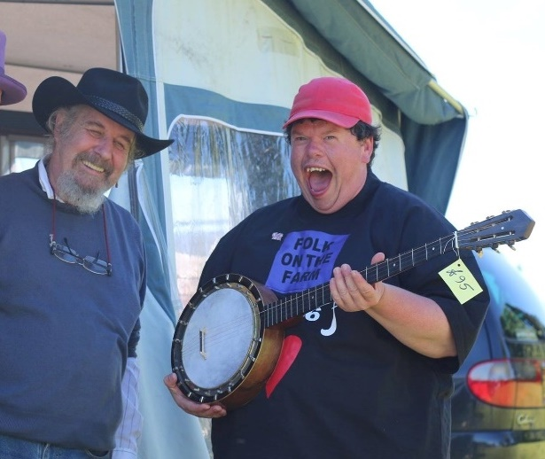
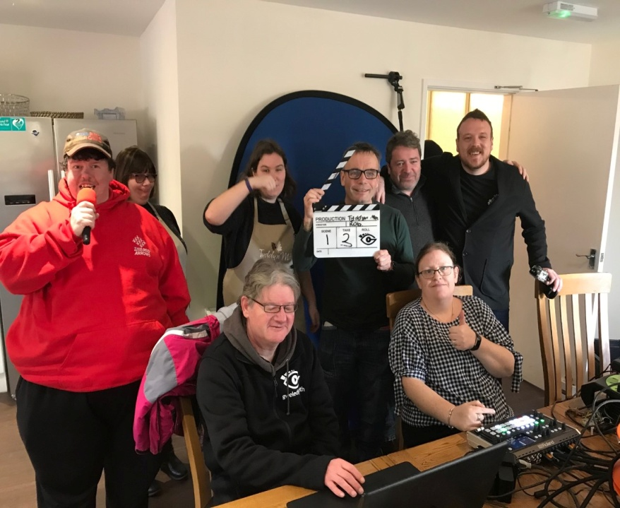
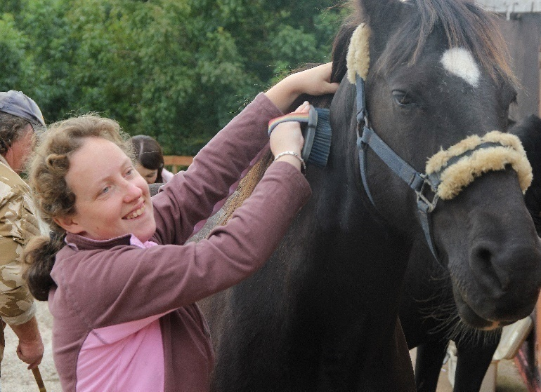
TYDDYN MÔN
tyddynmon.co.uk

Slide 12
Disgrifiadau ar gyfer Graddau Rhagorol
Descriptions for Gradings of Excellent
Caiff y canlyniadau i'r bobl sy'n defnyddio gwasanaethau eu cyflawni'n gyson ac maent o ansawdd uchel. Mae darparwyr gwasanaethau yn mynd ati i chwilio am opsiynau newydd i alluogi'r bobl i gael profiadau cadarnhaol a gwella eu bywydau. Mae adborth am effeithiolrwydd y gwasanaeth yn ei ddisgrifio fel gwasanaeth neilltuol a/neu wasanaeth sy'n arwain y sector.
Mae ansawdd y gofal a'r cymorth a ddarperir yn neilltuol a/neu'n arwain y sector. Cynllunnir gofal a chymorth drwy gynnwys y bobl ac mewn ffordd sydd wedi'i theilwra i gyflawni eu canlyniadau personol. Caiff gwersi eu dysgu/rhannu ag eraill i wella gwasanaethau. Mae darparwr y gwasanaeth yn mynd ati i geisio cyfleoedd i ddysgu a rhannu arferion da ym mhob rhan o'r sector.
Mae trefniadau arweinyddiaeth a rheolaeth y gwasanaeth yn neilltuol a/neu'n arwain y sector. Mae'r arweinyddiaeth arloesol, y gwaith llywodraethu a'r diwylliant cadarnhaol y mae'n ei greu yn llywio ac yn gwella canlyniadau. Grŵp o staff llawn cymhelliant, medrus a chadarn sy'n cael cymorth a hyfforddiant cynhwysfawr er mwyn cyflawni canlyniadau o ansawdd uchel i'r bobl.
Outcomes for people who use services are consistently achieved and of high-quality. Service providers actively seek out new options to enable people to have positive experiences and improve their lives. Feedback about the effectiveness of the service describes it as outstanding and/or sector leading.
The quality care and support provided is outstanding and/or sector leading. Care and support is designed through involvement with people and tailored to achieve their personal outcomes. Lessons are learned/shared with others to improve services. The service provider actively seeks out opportunities to learn and share good practice across the sector.
Leadership and management of the service is outstanding and/or sector leading. Innovative leadership, governance and the positive culture it creates drive and improve outcomes. Highly motivated, skilled and stable staff group who receive comprehensive support and training in order to deliver high-quality outcomes for people.

Slide 13
Gwybodaeth ar gyfer yr ymweliad cyntaf
Information for the initial visit
Gwybodaeth a data cyffredinol ynghylch pobl sy’n cael cymorth - Gwybodaeth ynghylch gwasanaethau, data staff, cyfraddau trosiant staff etc.
Ffeiliau polisi a Llawlyfr staff
Matrics hyfforddiant staff a Matrics goruchwylio staff
Adroddiad sicrhau ansawdd
Adroddiadau ymweliad Unigolion Cyfrifol
Adroddiadau adolygu Ansawdd Gofal
Adroddiadau adnoddau
Generic data and Information about people receiving support- Information about services, staff data, staff turnover rates etc.
Policy files and Staff handbook
Staff training matrix and Staff supervision matrix
Quality assurance report
RI visit reports
Quality of Care review reports
Resources reports

Slide 14
Ceisio Safbwyntiau Pobl
Seeking views of People
Ceisir adborth gan unigolion, staff, teuluoedd a gweithwyr proffesiynol.
Arolygon ar-lein ar gyfer staff, teuluoedd/ffrindiau.
Gwneud nodyn o unrhyw un nad yw’n gallu cwblhau’r holiadur ar-lein a phwy sydd eisiau cynnig adborth. Cysylltodd ein harolwg â nhw, fel bod eu barn wedi’i chynnwys.
Gellir cyflwyno adborth ar unrhyw adeg gan ddefnyddio’r dolenni
Feedback is sought from individuals, staff, families and professionals.
Surveys online for staff, families/friends.
Make a note of any people that are unable to complete the online questionnaire and who want to provide feedback. Our inspector contacted them so their views were included.
Feedback can be provided at any time using the links

Slide 15
“Bydd yr arolygiad yn canolbwyntio’n benodol ar y deilliannau sydd wedi'u cyflawni gan unigolion sy’n defnyddio’r gwasanaeth.”
Tystiolaeth:
bod lleisiau pobl sy’n defnyddio’r gwasanaethau'n cael y statws uchaf.
bod deilliannau’n cael eu personoleiddio, eu cyd-gynhyrchu, y gwaith paratoi sy’n cael ei wneud cyn inni ddechrau cefnogi rhywun, a'r effaith.
bod pobl yn cael y cymorth iawn i fyw y bywyd maent yn dewis ei fyw.
bod staff yn cael y cymorth iawn i ddatblygu yn eu rolau.
bod gan yr elusen ddiwylliant sy’n galluogi arloesedd.
bod dysg yn cael ei rhannu, drwy weithio ag eraill ar brosiectau a rhannu gwybodaeth ag eraill.
“The inspection will particularly consider the outcomes being achieved by individuals who use the service.”
Providing Evidence:
that the voices of people who use the services are given the highest status.
that outcomes are personalised, coproduced, the preparation work that takes place before we start to support someone and the impact.
that people are given the right support to live the life they choose.
that staff are given the right support to develop in their roles
that the charity has a culture where innovation can happen.
that learning is shared, working with others on projects and sharing knowledge with others.

Slide 16
Gwybodaeth Ychwanegol ar Gael
Additional Information Available
Fideos o bobl yn adrodd eu straeon eu hunain
Fideo o’r pandemig gyda chyfraniadau gan bobl sy’n cael cymorth, eu staff, teuluoedd ac ymddiriedolwyr
Gwybodaeth wedi’i pharatoi gan bobl sy’n cael cymorth ar gyfer pobl eraill
Astudiaethau achos, cynnydd a ddangosir ar y system gofal electronig.
Lluniau
Gwybodaeth yn yr adroddiadau Adolygu Ansawdd Gofal
Tystiolaeth o adroddiadau ymweliad Unigolion Cyfrifol (gan ddefnyddio safonau REACH)
Manylion unrhyw brosiect a gweithio a chwrdd ag eraill
Gwybodaeth ynghylch unrhyw gyfarfodydd allanol gyda llunwyr polisïau
Videos of people telling their own stories
Pandemic video with contributions from people receiving support, their staff, families and trustees
Information prepared by people receiving support for others
Case studies, progress shown on the electronic care system.
Photographs
Evidence from the quality of Care Review reports
Evidence from RI visit reports (using REACH standards)
Details of any projects and working and meeting with others
Information with any external meetings with policy makers.

Slide 17
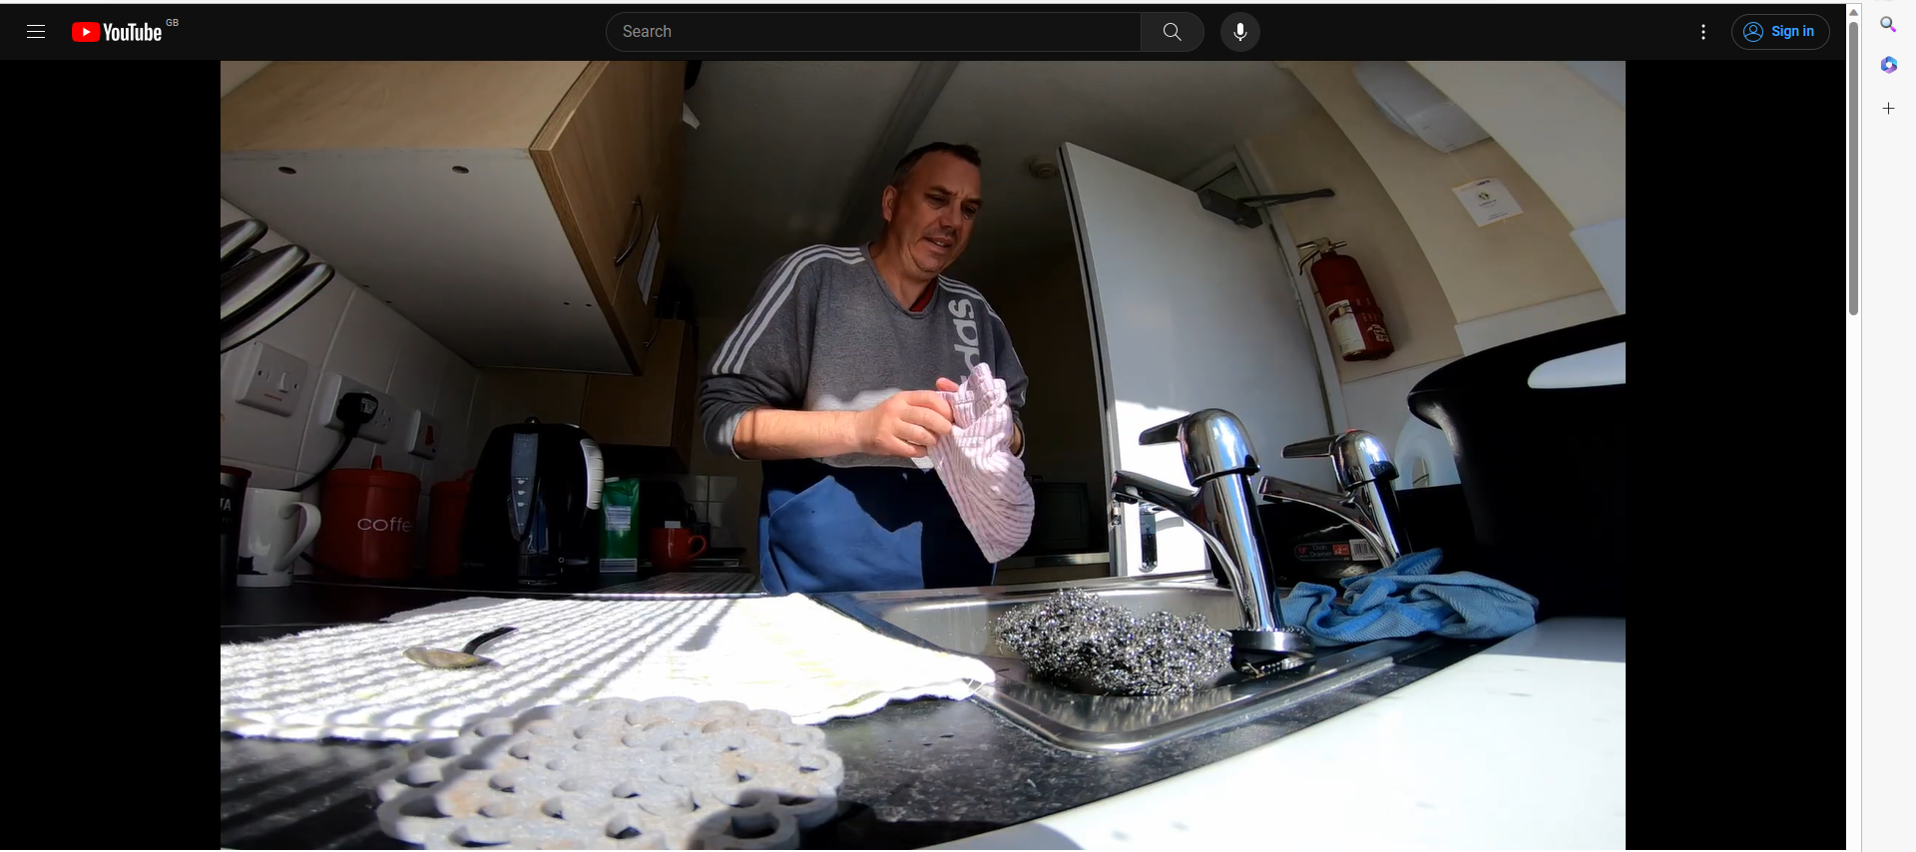
Cipio straeon / Capturing stories

Slide 18
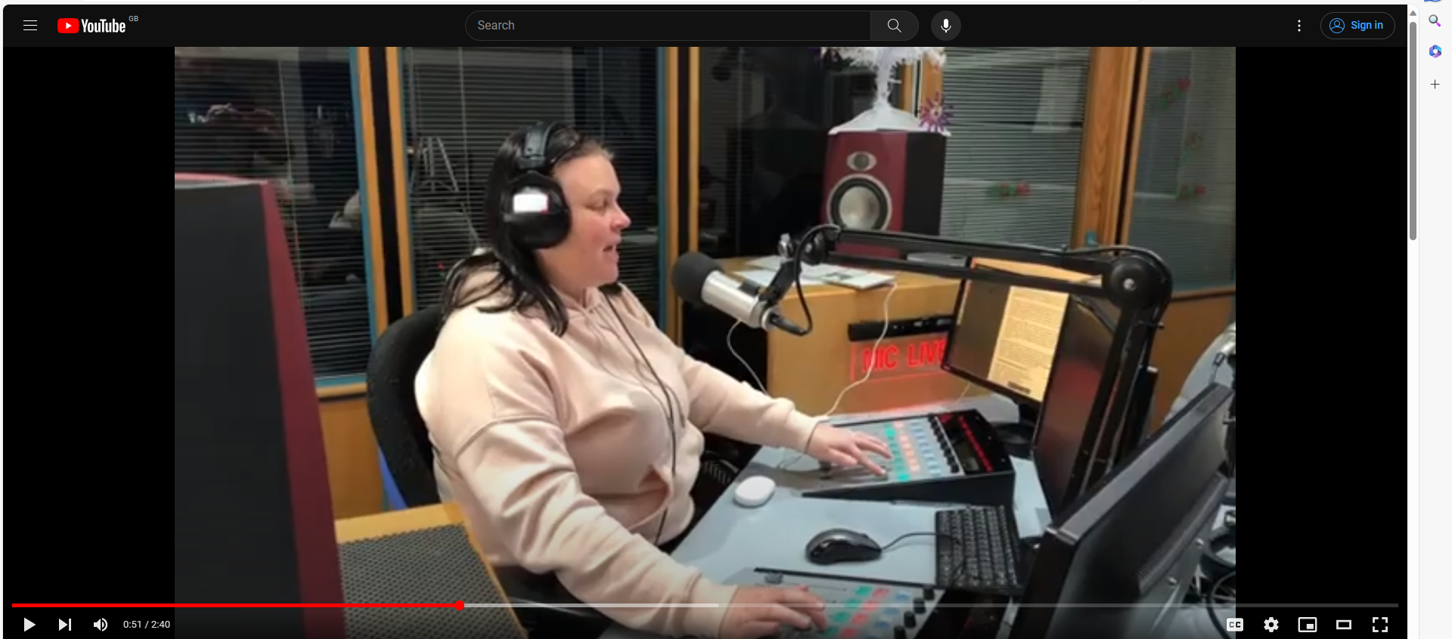
Cipio straeon / Capturing stories

Slide 19
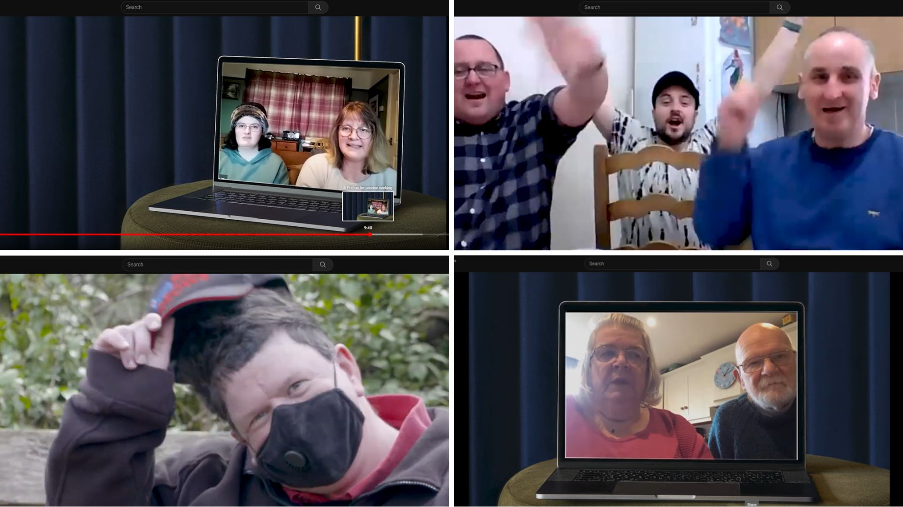

Slide 21
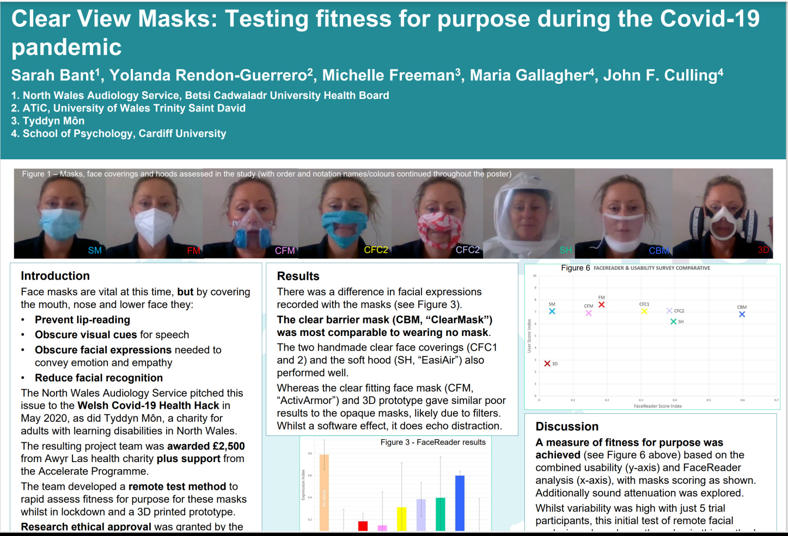
PROSIECT MWGWD CLIR CLEAR MASK PROJECT

Slide 22
Profiad hynod gadarnhaol ar y cyfan.
Rydym o’r farn bod safon a chryfderau’r gwasanaeth wedi’u cydnabod.
Cyfle i ofyn am gyngor, eglurhad o Ddeddf Rheoleiddio ac Arolygu Gofal Cymdeithasol
Overall a very positive experience.
We felt the strengths and qualities of the service were recognized.
A chance to ask for advice, clarification on RISCA

Slide 23
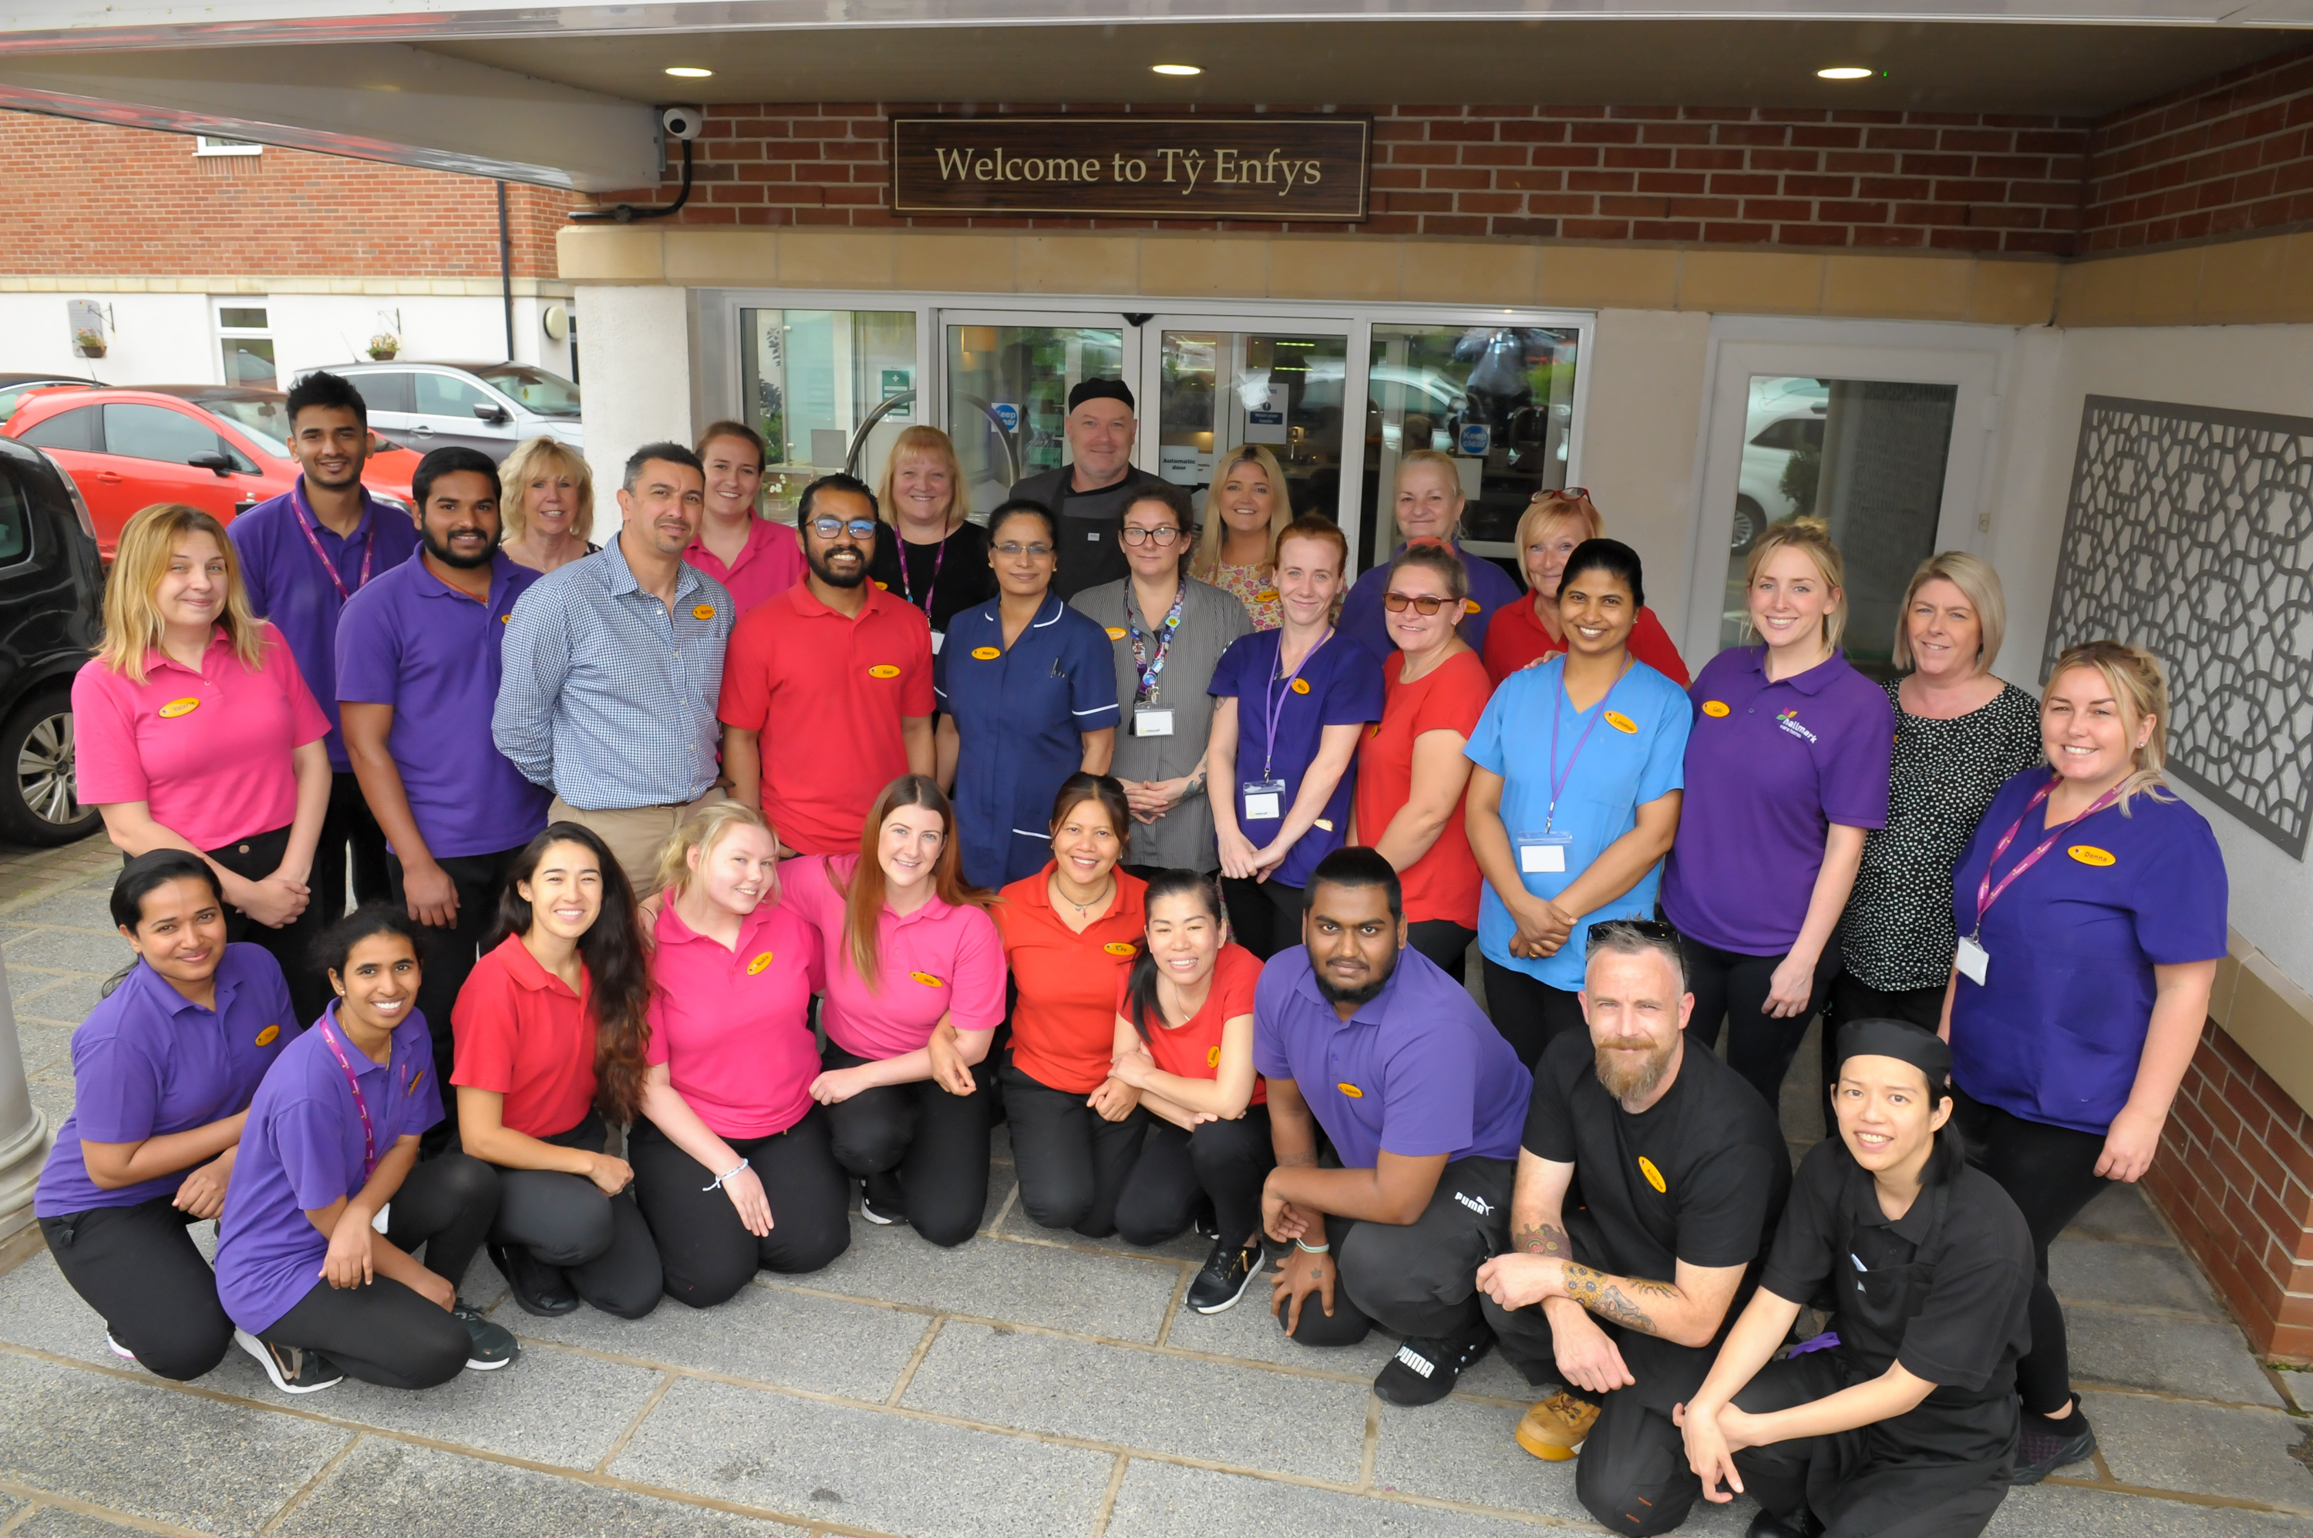
The System &
The Secret Sauce….

Slide 24
Aneurin Brown
Managing Director – Hallmark Care Homes
Bethan Hurley
Customer Relationship Manager – Ty Enfys Care Home

Slide 25
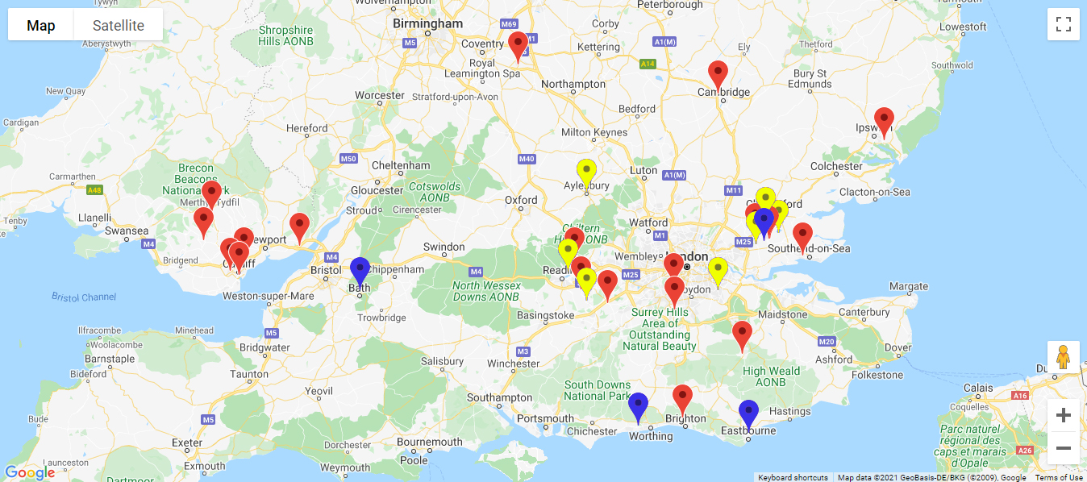
Hallmark Care Homes
20 care homes across England and Wales.
1 Retirement Living Village & Domiciliary Care Service
2 Homes under construction
Established in Pontypridd in 1997

Slide 26
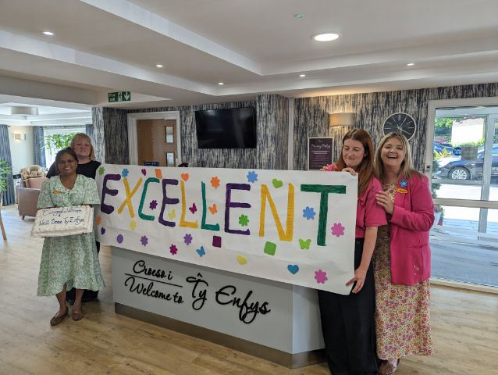
Our approach to “Excellent”….

Slide 27
Our approach to ‘Excellent’…
Have and believe in a strong vision – The WHY ?
Set the internal bar high - NLTAG
Be prepared to go through the gears to get to ‘Excellent’
Be ‘Ratings Ready’ & ‘Inspection Ready’ at all times
Excellence is not about ‘perfection’….
Outstanding Pathways
Robust Quality Assurance Processes

Slide 28
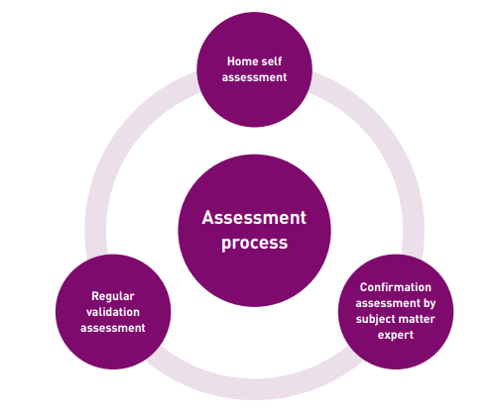
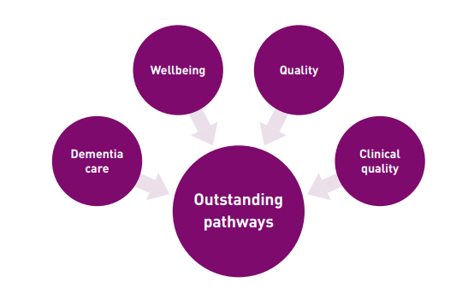

Slide 29
Our Report…
The service is dedicated to providing high quality care and support. The service vision and ethos is implemented by every member of staff. Strong governance is in place, aided by a clear management structure. There are robust auditing systems as well as quality assurance arrangements. Managers, senior managers and the Responsible Individual (RI) have extensive oversight of the service and ensure that high quality is embedded and maintained.

Slide 30
Hallmark Care Homes
Schedule of audits
Reviewed by home team and regional team
Peer auditing
Auditing software
Observational Tools
“Close the loop”
To be recognised as the leading provider of high-quality care for all residents.
The service is dedicated to providing high quality care and support. The service vision and ethos is implemented by every member of staff. Strong governance is in place, aided by a clear management structure. There are robust auditing systems as well as quality assurance arrangements. Managers, senior managers and the Responsible Individual (RI) have extensive oversight of the service and ensure that high quality is embedded and maintained.
Compliance Audit
Audit Trend Analysis
Survey Results
Monitor KPI’s
Governance System
Electronic Care Planning
EMAR
Remote monitoring
“Hi NYE”
QA Policy
Internal Audit
External Audit
Surveys
RI Visits
Action Plan
Quality of Care Review
Organisational Design
Clear job roles
Home Vs Regional

Slide 31
About Ty Enfys
Registered for 101 residents
Opened in 2007
Purpose built building offering: residential, dementia & nursing care
Heads of department team of 10
Total of 170 Team Members on payroll

Slide 32
Passion and commitment to achieving excellent.

Slide 33
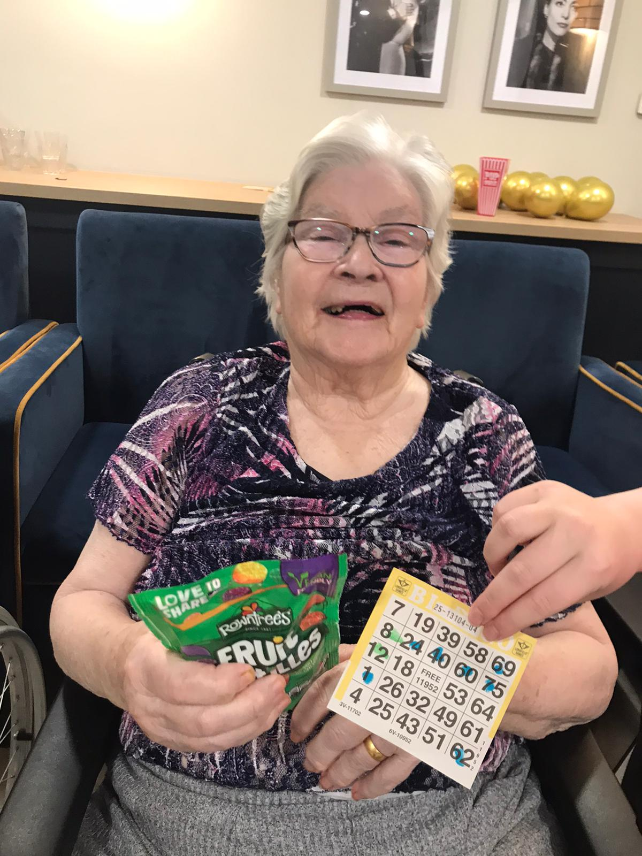
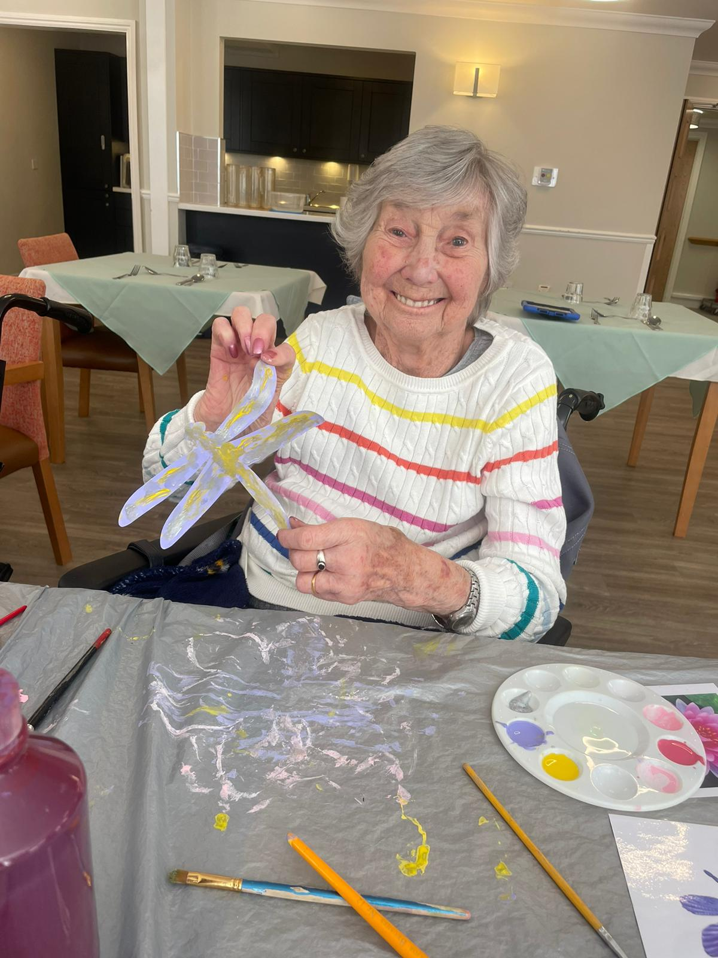
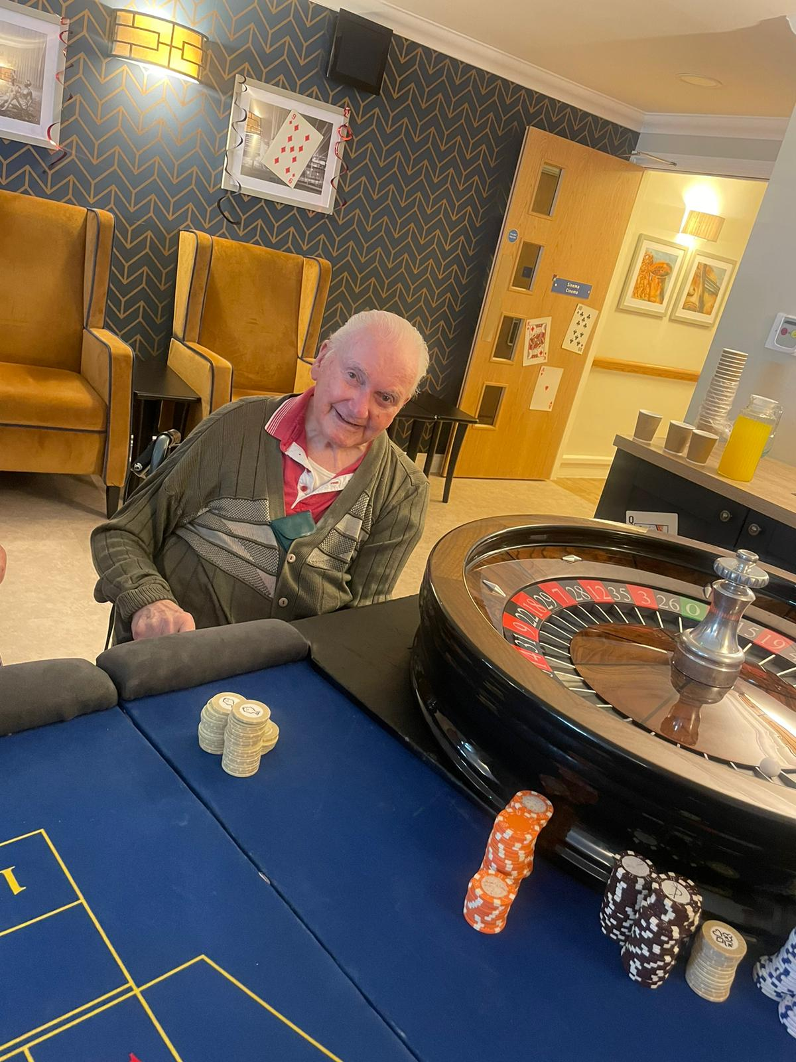
Promoting residents independence and building relationships

Slide 34
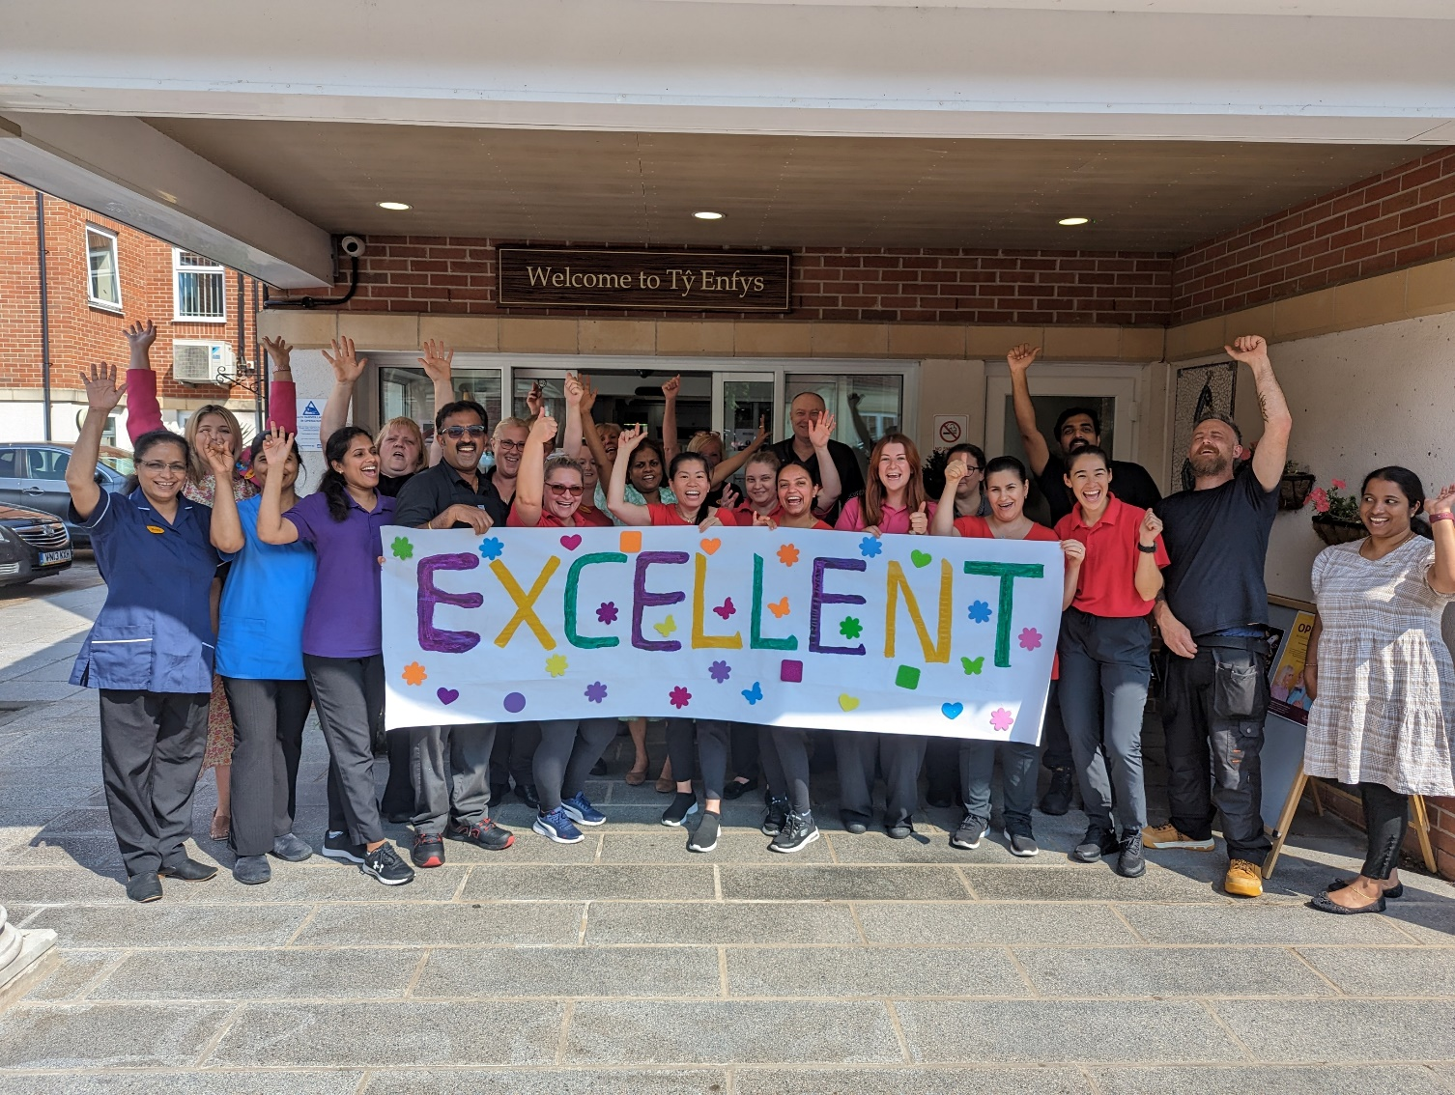
Team work

Slide 35
Questions
www.linkedin.com/in/aneurinbrown/
www.linkedin.com/in/bethanhurleycrm
nye@hallmarkcarehomes.co.uk
bethan.hurley@hallmarkcarehomes.co.uk
@ANEURINBROWN

Slide 36
Rôl yr Unigolyn Cyfrifol / Role of the RI
Legislation - 2016 Act
Why
Who
Responsibilities
Governance
Consultation
Quality assurance
Round table discussion
Three things that are going well
Three challenges
Support for RI’s:
Social Care Wales - RI community - https://communities.socialcare.wales/sign-up charlotte.powell@socialcare.wales
Deddfwriaeth - Deddf 2016
Pam
Pwy
Cyfrifoldebau
Llywodraethu
Ymgynghori
Sicrhau ansawdd
Trafodaeth bord gron
Tri pheth sy'n mynd yn dda
Tair her
Cymorth i Unigolion Cyfrifol:
Gofal Cymdeithasol Cymru - cymuned Unigolion Cyfrifol
https://communities.socialcare.wales/cy/sign-up charlotte.powell@socialcare.wales

Slide 37
Adolygiad o Ansawdd y Gofal / Quality of Care Review
Discussion
Have you used the CIW Quality of Care Review template?
Was this useful for completing the annual return?
Anything to add/change?
Learning from the QA tools you use
Trafodaeth
Ydych chi wedi defnyddio templed Adolygiad o Ansawdd y Gofal AGC?
A oedd y templed hwn yn ddefnyddiol ar gyfer cwblhau'r datganiad blynyddol?
Unrhyw beth i'w ychwanegu/newid?
Gwersi i'w dysgu o'r adnoddau Sicrhau Ansawdd rydych yn eu defnyddio

